Slide 1

Predictive forecasting for Walmart sales data 2024-05-01 Leveraging machine learning for enhanced decision-making

Slide 2

AGENDA
INTRODUCTION
Data Collection and features
Data preprocessing
Exploratory data analysis (EDA)
Model building
Model evaluation
Results
Conclusion and recommendations
Future work

Slide 3
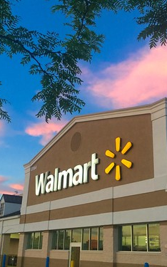
Introduction
Objective: Forecast weekly sales using historical data
Significance: Optimize resource allocation and improve operational efficiency.
This Photo by Unknown Author is licensed under CC BY

Slide 4

Data collection and features
Source: internal Walmart dataset from Kaggle
Key features: store id, sales date, weekly sales, holiday flag, temperature, fuel prices, cpi,and unemployment rate.
Impact: features selected based on influence on consumer behavior

Slide 5
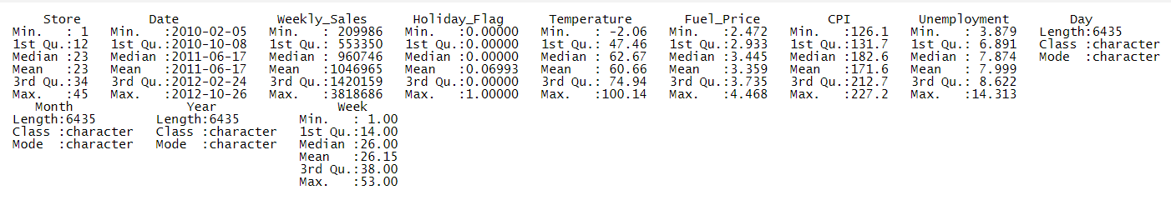
Data preprocessing
Missing values: Imputed using median values for `Weekly_Sales`, `CPI`, and `Unemployment`.
Error Corrections: Adjustments made for negative sales figures.
Feature Engineering: Date attributes expanded, holiday impacts categorized, temperature binned.

Slide 6

Exploratory data analysis
Correlation Analysis: Identify relationships between sales and variables like store size, temperature, and CPI.
Trend Analysis: Sales trends over years, months, and specific holiday periods.

Slide 7
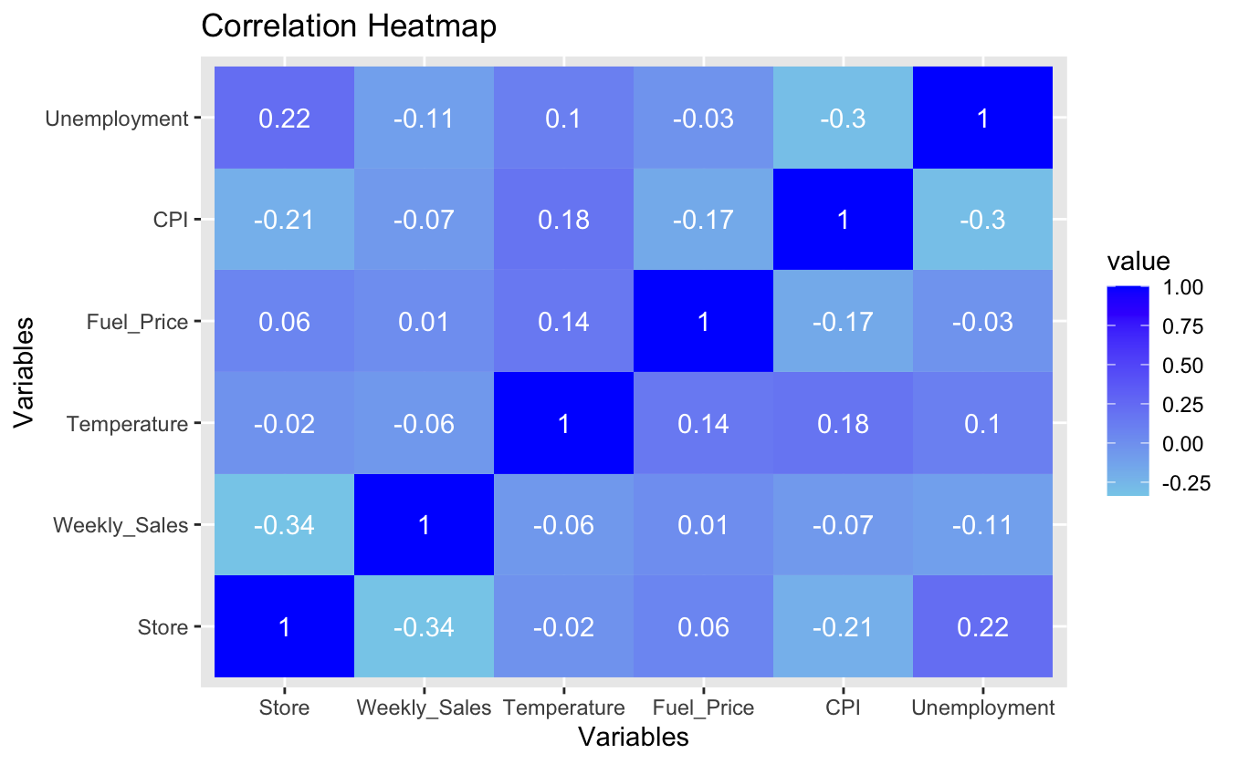
CORRELATION HEATMAP

Slide 8
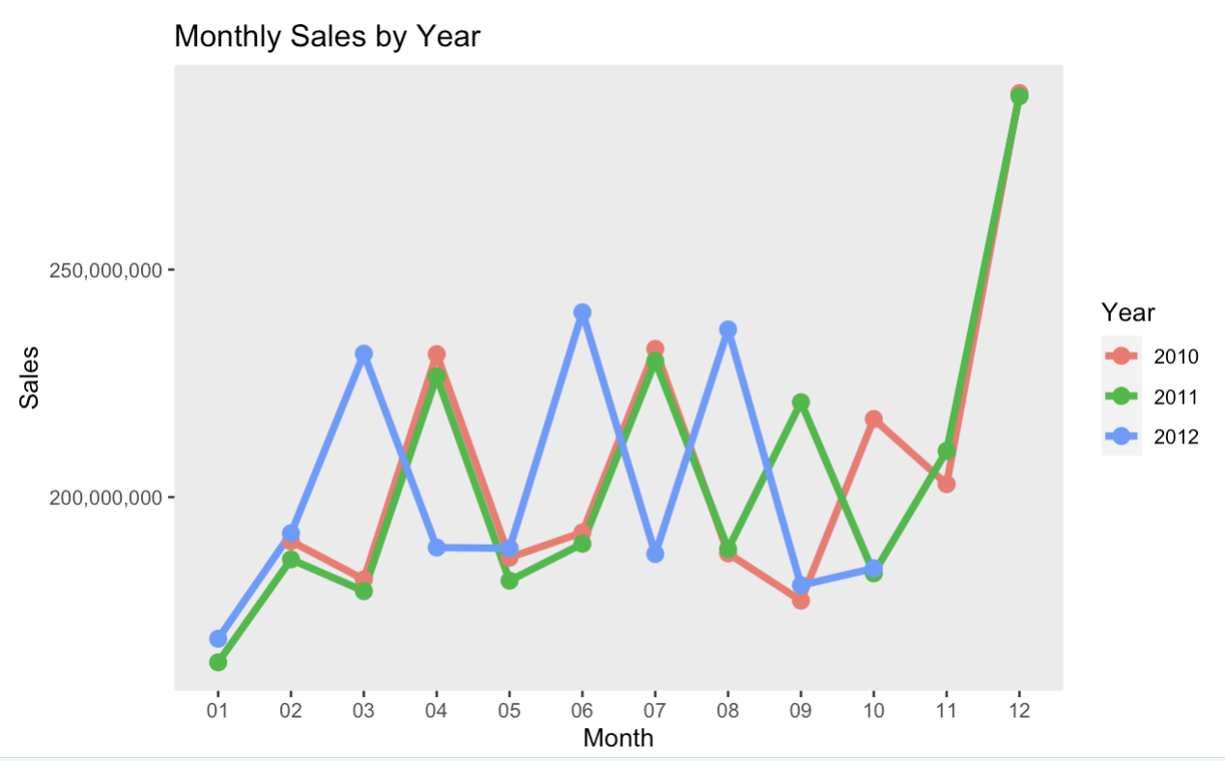
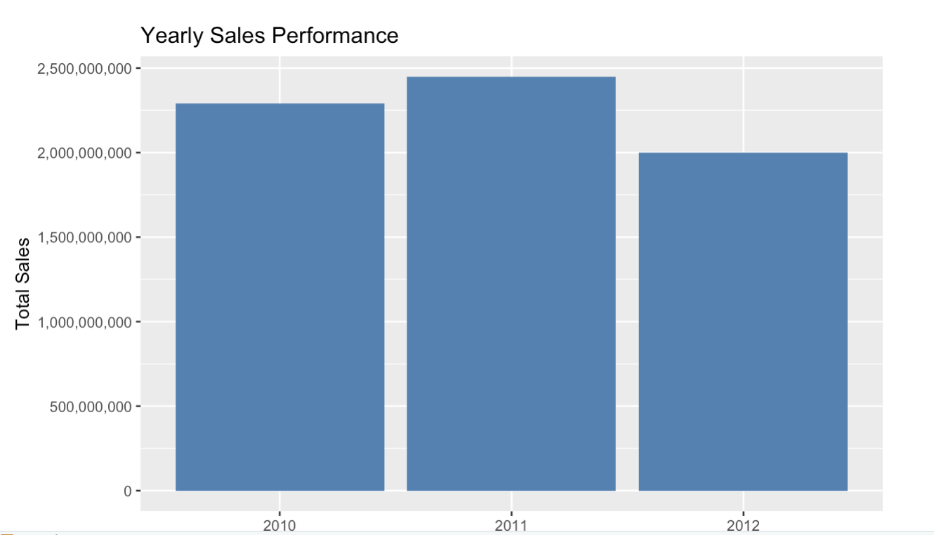
Annual sales trends

Slide 9
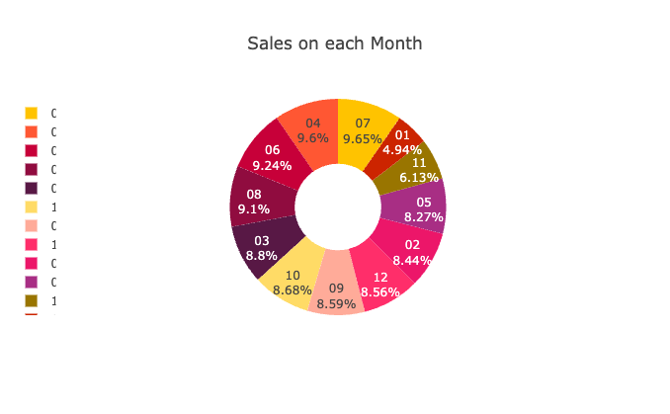
Monthly sales trends

Slide 10
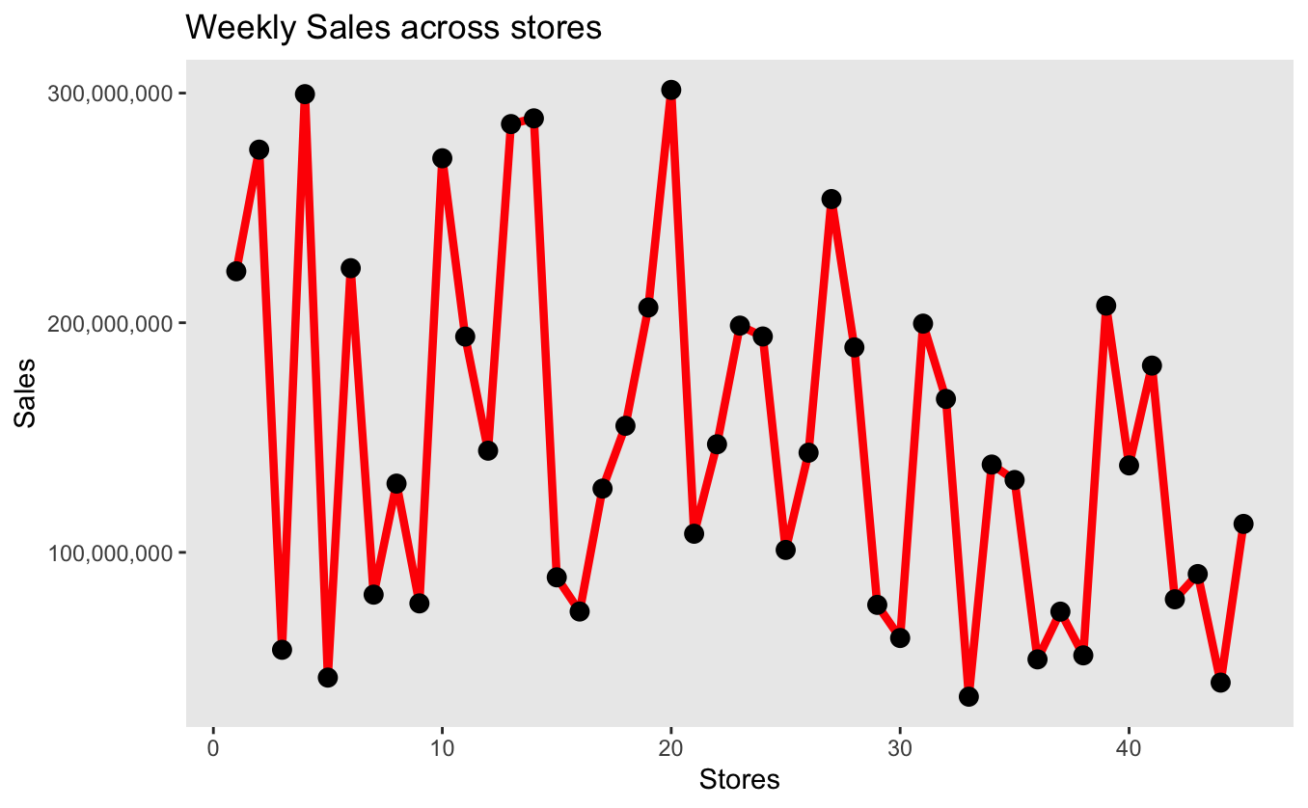
Weekly sales trends

Slide 11
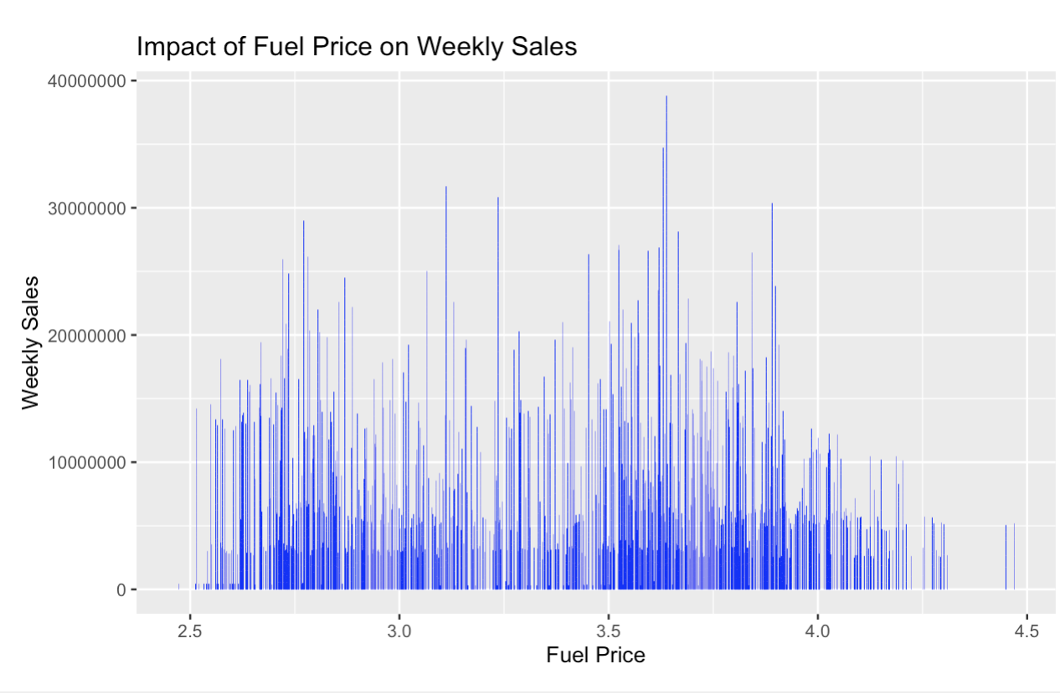
Impact of Fuel on Sales

Slide 12
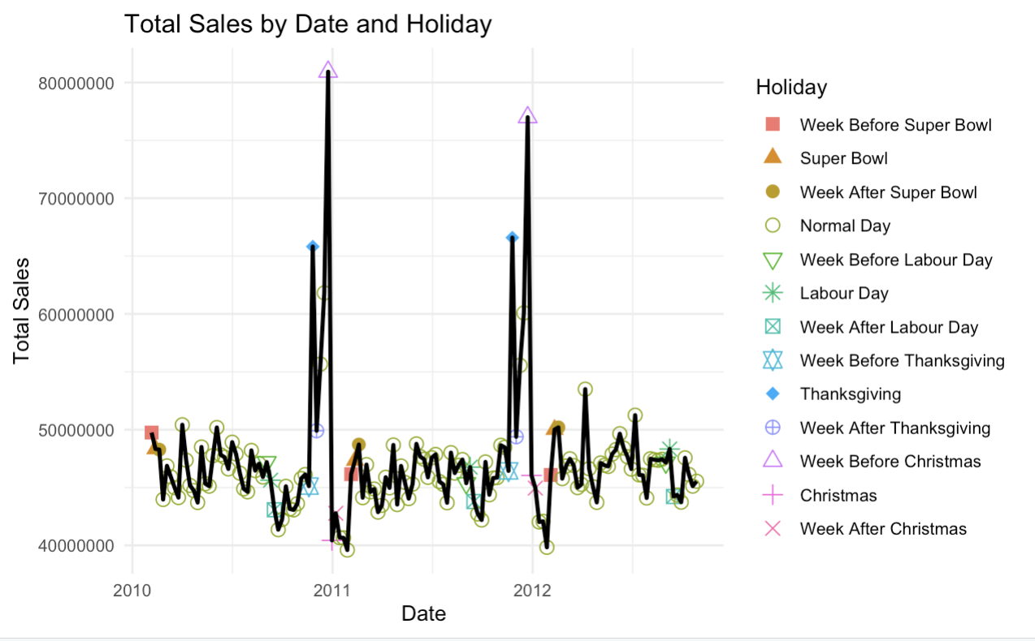
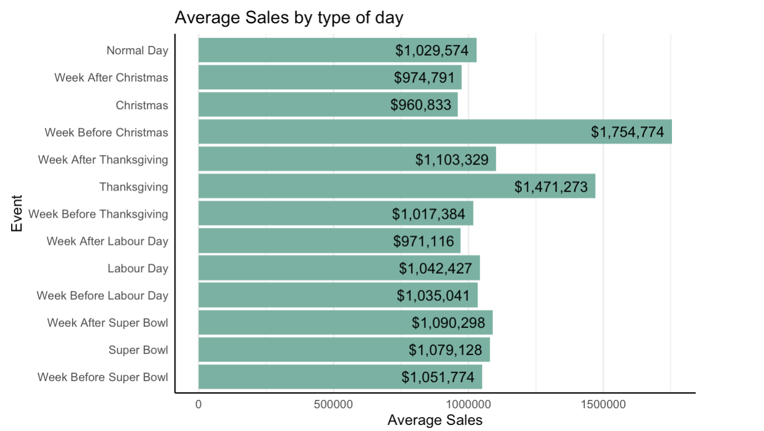
Sales by holidays

Slide 13
Model building
Models used: Multiple Linear Regression, K-Nearest Neighbor, decision tree, and random forest.
Purpose: each model tests different aspects of sales data
Evaluate the metrics – RSME, R-square value

Slide 14
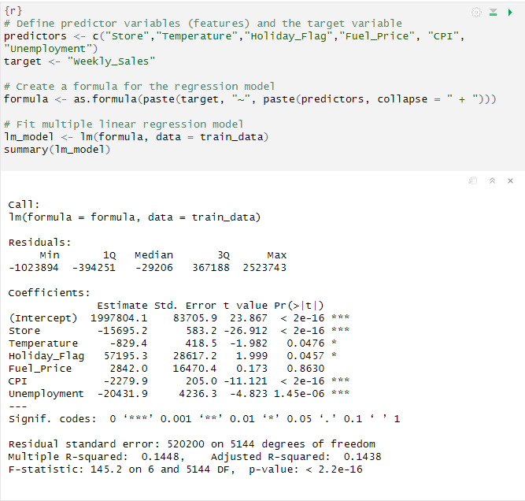
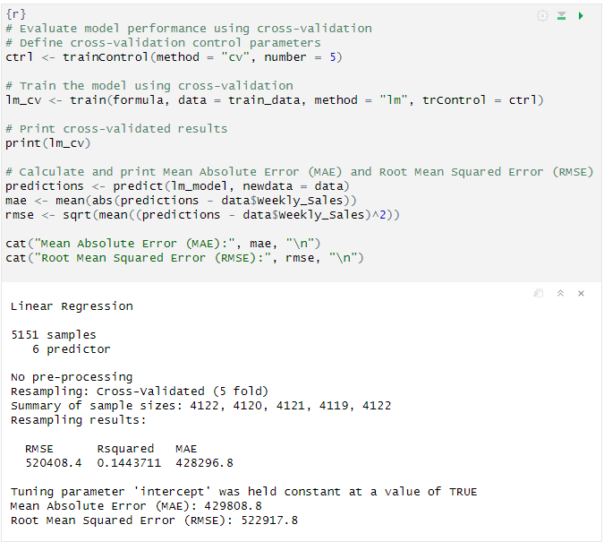
Multiple Linear Regression

Slide 15
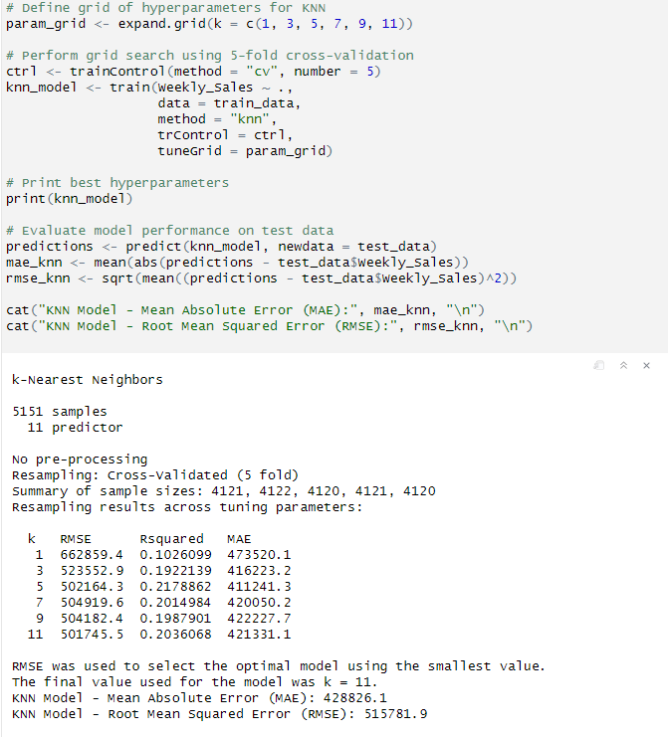
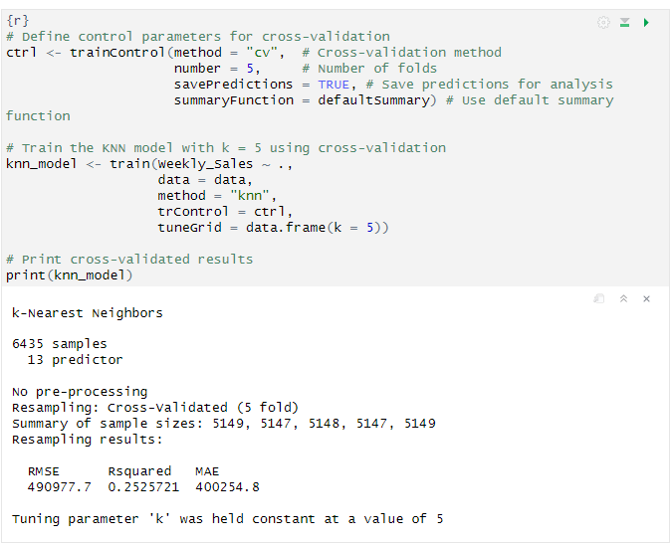
KNN (k-NEAREST NEIGHBOUR)

Slide 16
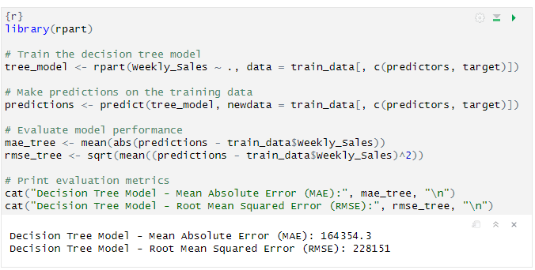
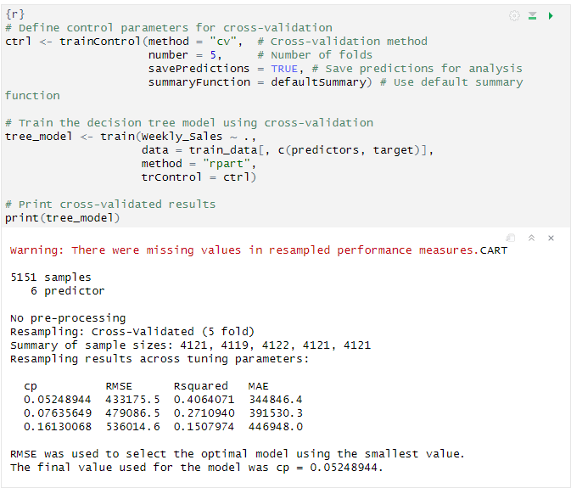
Decision Tree

Slide 17
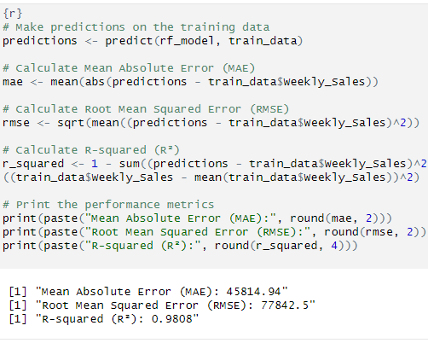
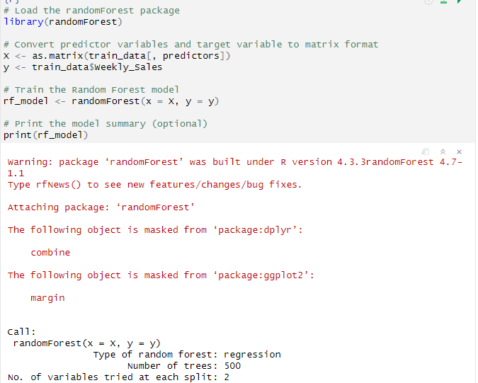
Random forest

Slide 18
Model Evaluation
Model | MAE | RMSE | R^2
MLR | $210,000.00 | $275,000 | 0.15
KNN | $401,924.10 | $490,811.80 | 0.2185
Decision Tree | $158,450.80 | $223,141.40 | 0.4135
Random Forest | $45,648.45 | $80,167.08 | 0.9799
Comparing all the values, we’ve decided to go forward with Random Forest model

Slide 19
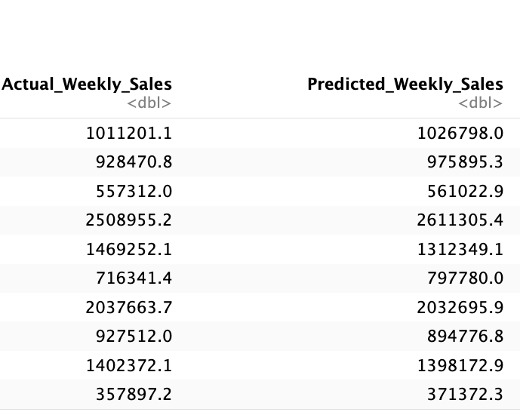
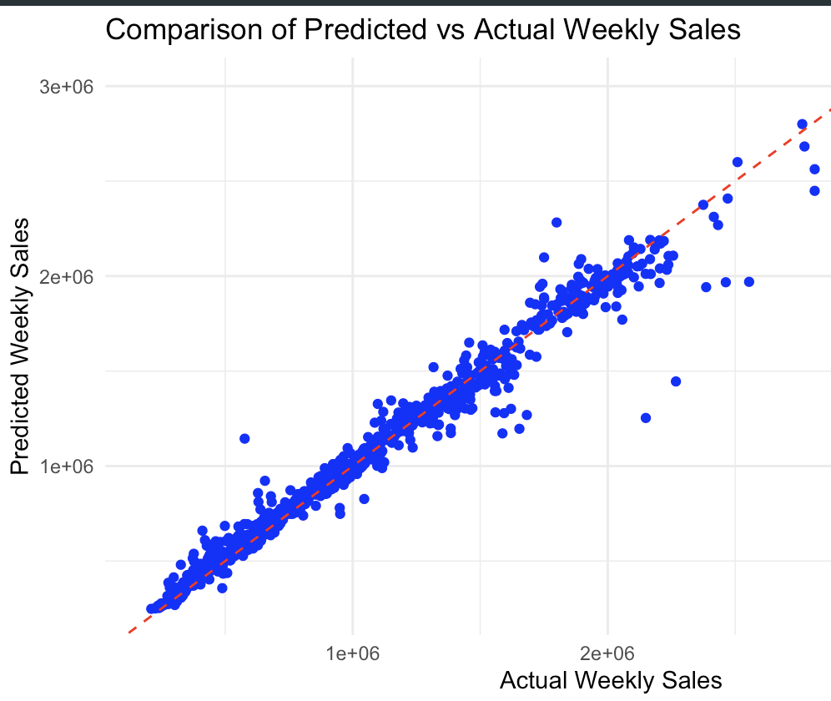
RESULTS ON TEST DATA

Slide 20
conclusion and recommendations
Random Forest was the best model due to its accuracy and robustness
Recommendation for real-world sales forecasting
Enhances decision-making and operational efficiency.

Slide 21
Future work
Further tuning of model parameters, and incorporation of more dynamic market data.
Experiment with other machine learning models.
Potential usage of AI in customer behavior and sales prediction

Slide 22

THANK YOU

